Slide 1


Navigating Changes in
Post-Secondary Funding
INvestEdIndiana.org

Slide 2


We’ll Discuss…
Supporting Students
College Planning Presentation
Financial Aid Night
In the News
Student Loan Changes

Slide 3

INvestEd - Who are we?
Indiana based nonprofit established in 1980 with the mission:
  Provide Hoosiers the tools they need to put education beyond high school within reach & limit student loan debt
Offer FREE education planning assistance
  Over 1,100 events across the state
  Over 70,000 attendees at events
  Over 10,000 individuals helped
  Over 1,500 FAFSA’s filed

Slide 4
Supporting Students:
Best Practices

Slide 5
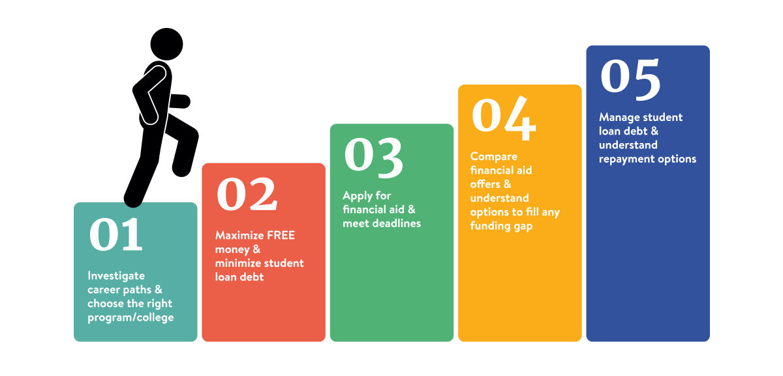
Helping Families Every Step of the Way

Slide 6

Advising Events and Resources
Advising Events
  Deliver comprehensive financial aid & education funding programming statewide
One-on-one help via phone, email, text, or live chat
  Easily accessible experts in Indiana providing timely answers is crucial
Printed Resources and Materials
  Postsecondary Education Planning Guide
  One-Page Data Sheets – In English and Spanish
    Scholarship Search Help, Creating an FSA ID, FAFSA Checklist, etc.
Online Tools
  College Planning Toolbox

Slide 7
Planning and Paying Events
Postsecondary Education Planning
  Get families informed & energized about planning ahead, no matter where they are in the process
    Junior high or early high school aged students (Ideally)
Financial Aid Night
  Discuss deadlines and important steps for a solid college funding plan
  Demystify the FAFSA process & documents
  Highlight financial aid timeline and details of offer letters
    Focus on high school seniors to establish a detailed plan to pay for college

Slide 8
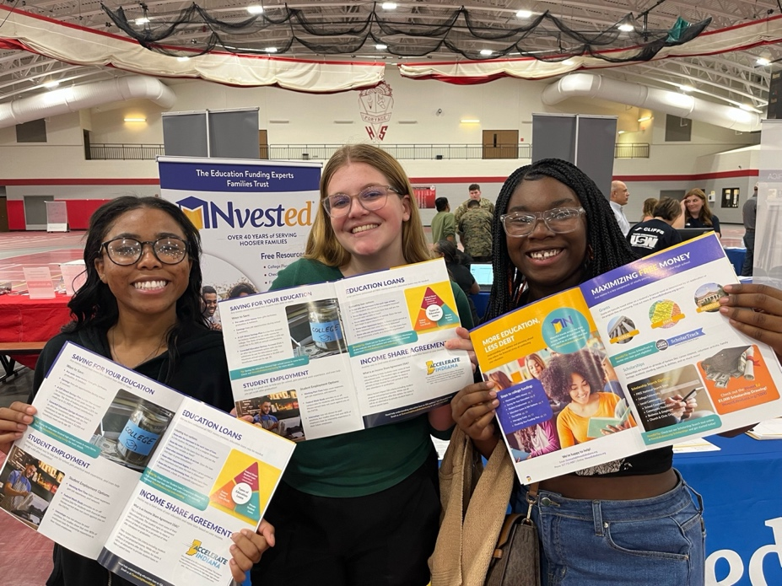
Documentation and Follow-up Events
FSA+ Event
  Explain financial aid forms
  Setting up StudentAid.gov Account to enable filing
FAFSA Completion Event
  Families file the FAFSA at the school or organization
FAFSA Follow-Up Event
  Hoosier students finalize their plan to pay for college
  Provide tools to help families compare financial aid offers for more informed decisions
  Understand student loan options & impact of borrowing

Slide 9
A Closer Look at Our Presentations
Early College Planning

Slide 10
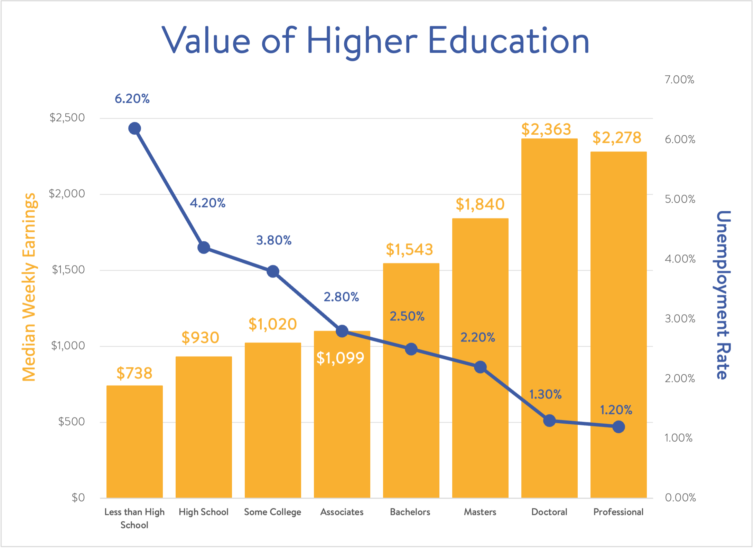
Value of Higher Education
(Source: Current Population Survey, U.S. Department of Labor, U.S. Bureau of Labor Statistics)

Slide 11
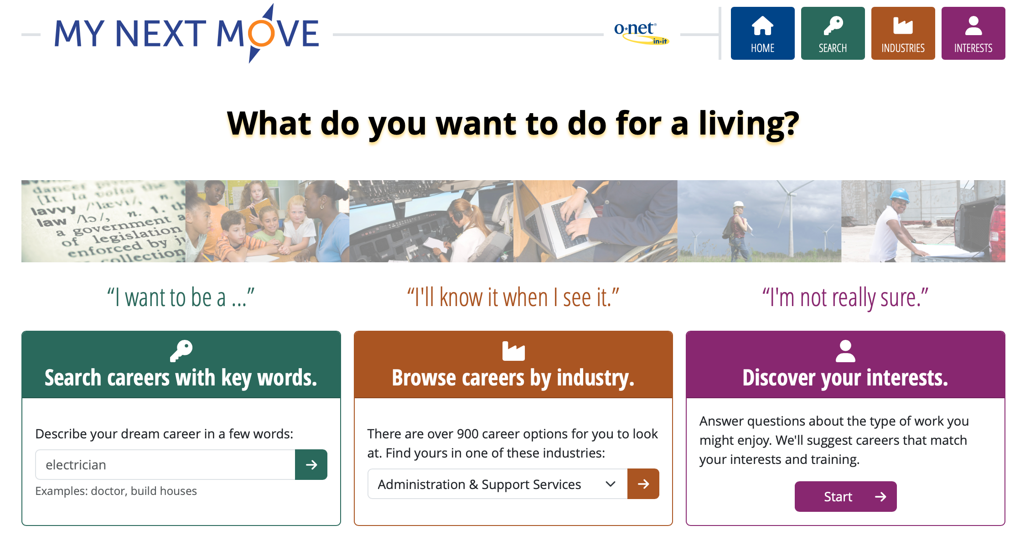
Career Research

Slide 12
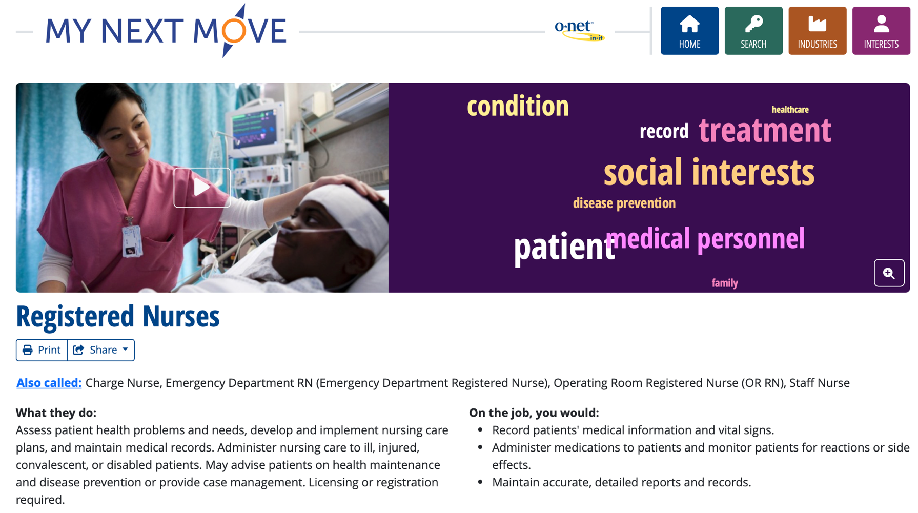
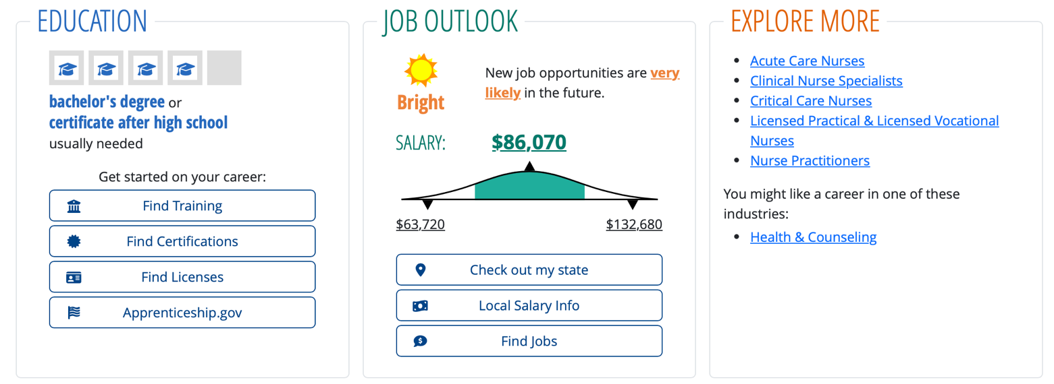
Career Research

Slide 13


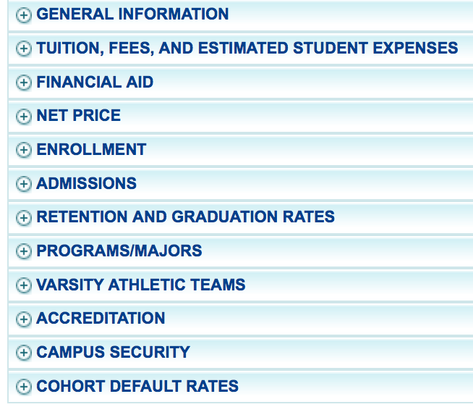

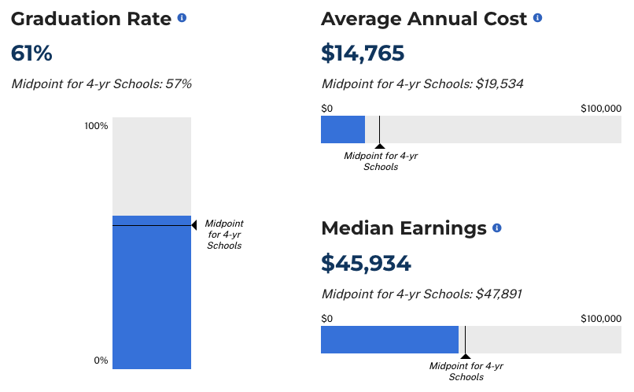
Choosing Your Program/College
Research your options
  Length of program
  Compare key elements
  Location & size
  Visit campus/facility
Online tools available at INvestEdIndiana.org/Choosingcollege

Slide 14
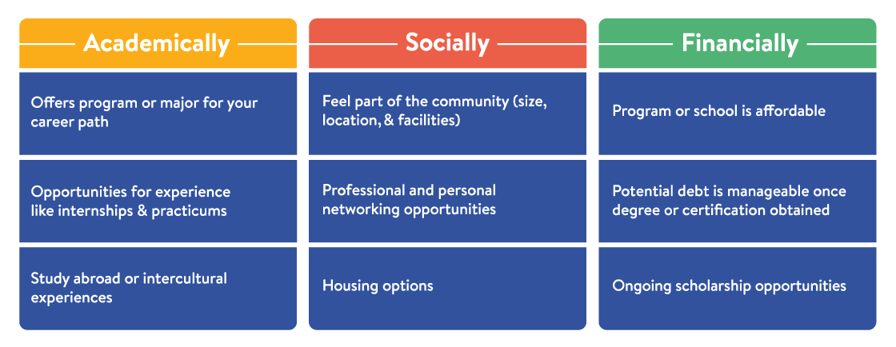
Find the Right Fit
Changing majors, programs or schools may add
  Extra time to complete degree
  Increased cost & student loan debt

Slide 15
A Closer Look at Our Presentations
Financial Aid Night

Slide 16
Grants
Federal
  Pell Grant - Max $7,395
  Supplemental Educational Opportunity Grant (SEOG) - $100-$4,000
  TEACH Grant - $3,772
State of Indiana
  21st Century Scholars
  Frank O’Bannon Grant Programs
  William A. Crawford Minority Teacher Scholarship
  Workforce Ready Grant
  Visit INvestEdIndana.org/Grants

Slide 17
Credit Completion
On -Time
Full - Time
30
Credits
24
Credits
15 Credits – Fall
15 Credits – Spring
12 Credits – Fall
12 Credits – Spring
60
Credits
48
Credits
12 Credits – Fall
12 Credits – Spring
15 Credits – Fall
15 Credits – Spring
90
Credits
72
Credits
15 Credits – Fall
15 Credits – Spring
12 Credits – Fall
12 Credits – Spring
120
Credits
96
Credits
15 Credits – Fall
15 Credits – Spring
12 Credits – Fall
12 Credits – Spring
120
Credits
12 Credits – Fall
12 Credits – Spring

Slide 18
Scholarships
Need Based vs. Merit Based
  Where to look for scholarships
  Visit INvestEdIndiana.org/Scholarships for more information
FREE National Search Sites
College/University
Local/Community
        School Counselor
        Community Foundation
        Business & Employer
        Church & Civic Organizations

Slide 20

Student Employment
Benefits
  Earn money to pay for college &
  minimize student loans
  Job & interview experience
  Build time management skills
Options
  Federal Work-Study
  Part-Time Employment
  Internships

Slide 21
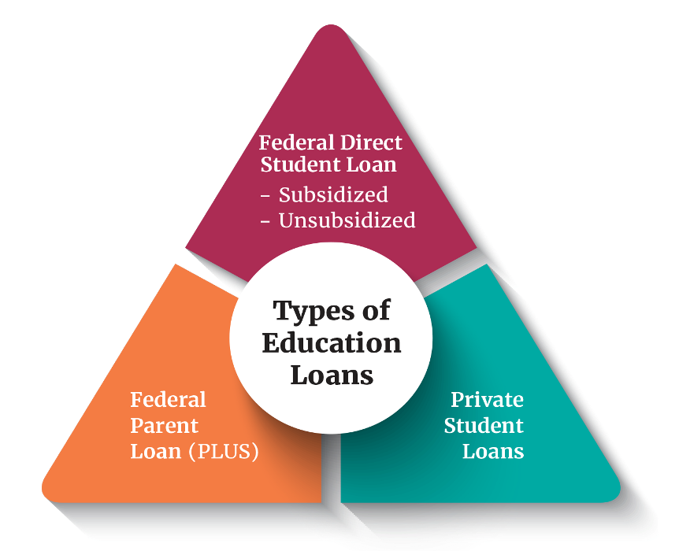
Education Loans
Federal Direct Loans
  Rate: 6.39% + 1.057% Fee
  Student’s Loans
  Subsidized & Unsubsidized
  Annual Limits
Federal Direct PLUS Loans
  Rate: 8.94% + 4.228% fee
  Parent’s Loans
  Eligibility impacted by adverse credit
Private Student Loans
  Rate: Based off credit, often no fees
  Student and Cosigner’s Loan
  Eligibility based on credit score and income

Slide 22
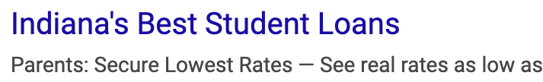
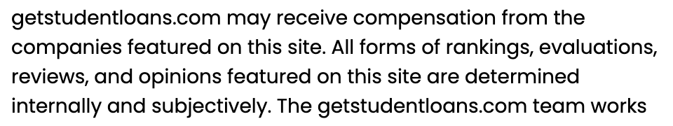
Education Loan - Trends
Online Searches and AI compile results based on many sites including those that offer “Top Picks” or “10 Best…”
Sponsored sites appear first
“As low as” Marketing
  Rates shown in ads emphasize lowest rates,
  but actual rate is often in the double digits
INvestEd Team can help
  Review specifics of loan types
  Discuss options for students/parents
  Answer questions

Slide 23
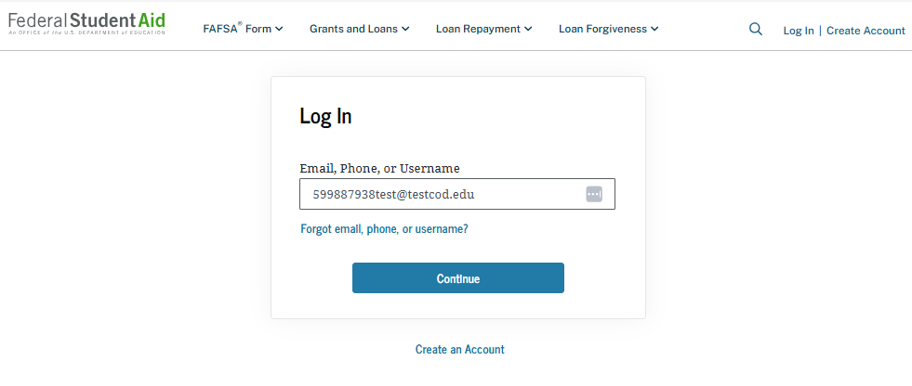
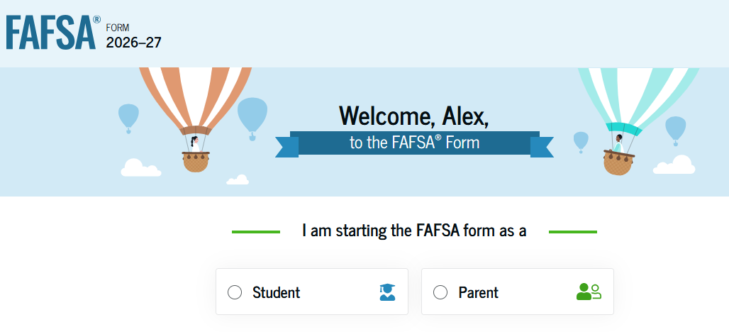
Start the FAFSA
StudentAid.gov
Login - Using your StudentAid.gov Account
Select Role
  Student
  Contributor (Parent)
FAFSA Onboarding

Slide 24
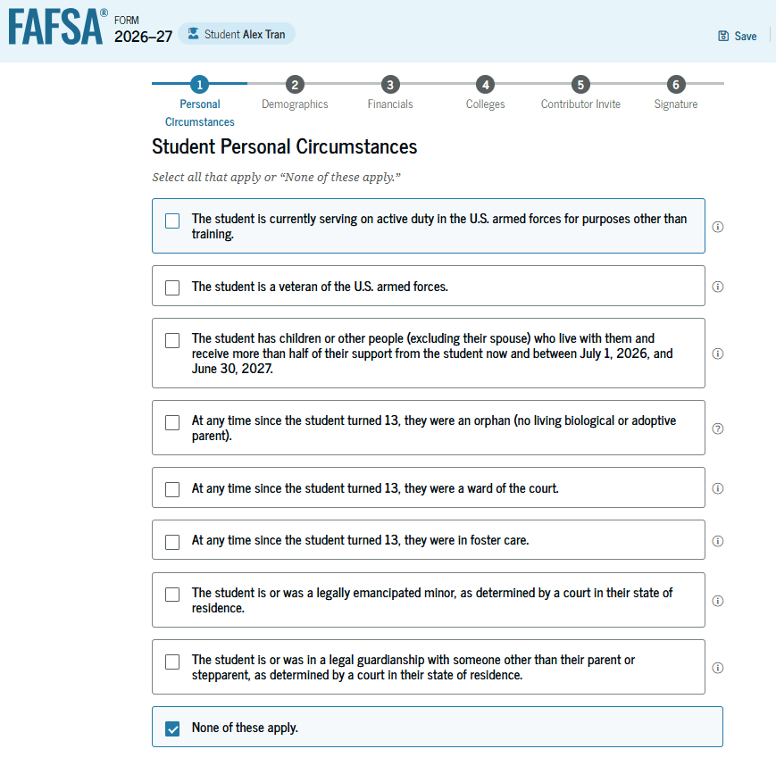
Student Personal Circumstances
Marital Status
  For the Student
College Plans
  Year in college for 2026 - 2027
Dependency Determination
  Born before January 1st, 2003
  Graduate/Professional student
  Student marital status
  At risk of being homeless
  Additional situations

Slide 25
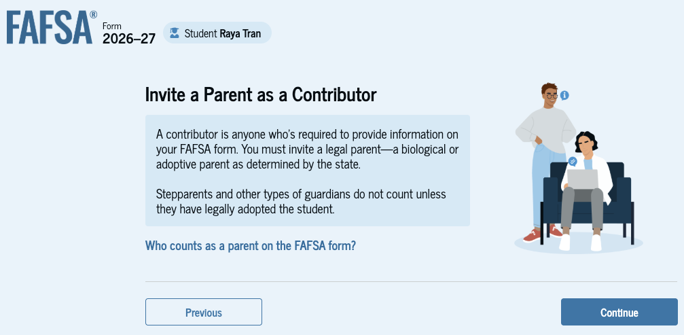
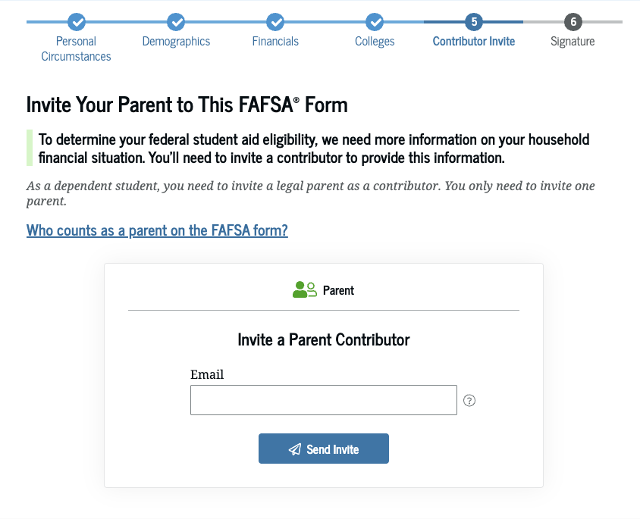
Inviting Contributors

Slide 26
Who is the Parent
Biological or adoptive parents
Married or unmarried & living together
Divorced, separated or unmarried & not living together
Widowed &
not remarried
Who provided more financial support the last 12 months?
If equal, which parent has the greater income & assets the last 12 months?
Both parents listed on the FAFSA
If parent single, then only person listed on the FAFSA
If parent remarried, then parent & step-parent listed on the FAFSA
Single parent listed on the FAFSA

Slide 27
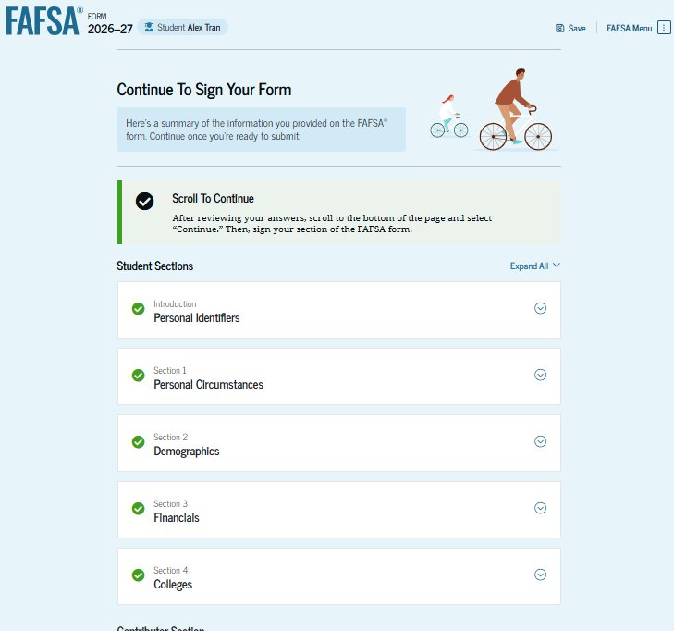
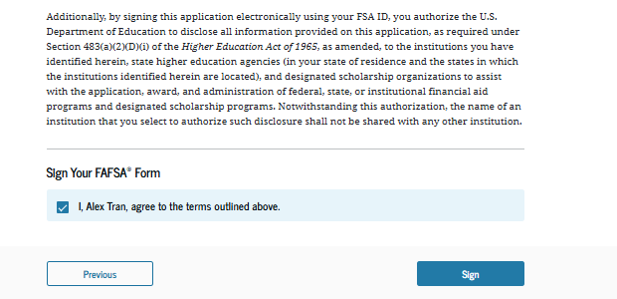
Review, Sign, & Submit
Student reviews all entered information
Student agrees and signs their part of the FAFSA

Slide 28
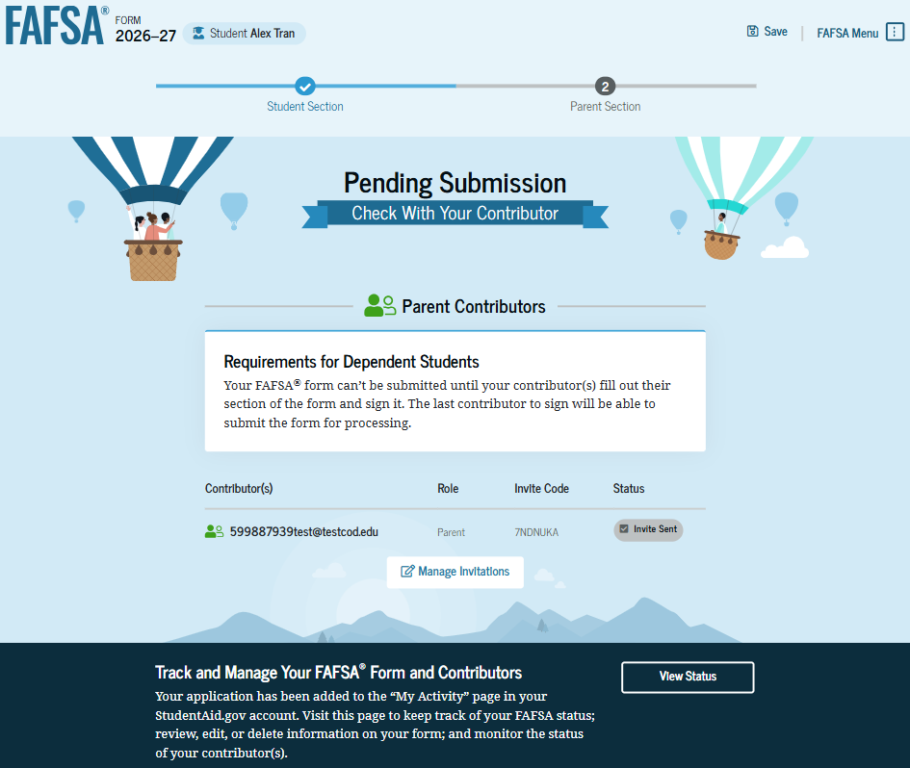
Student Section Complete
Note: The FAFSA is not submitted until the contributor(s) complete
and sign their sections of the form.

Slide 29
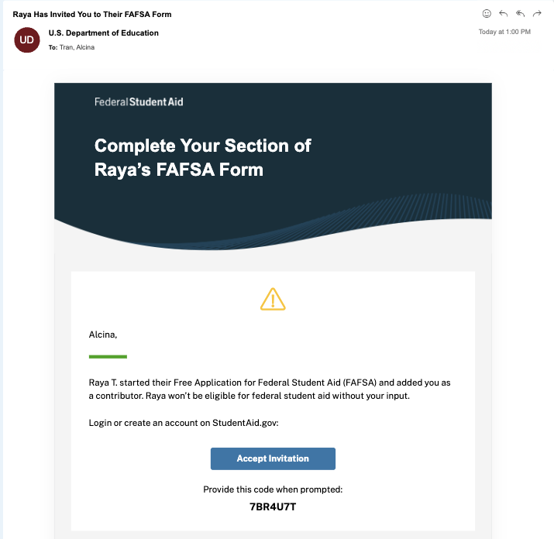
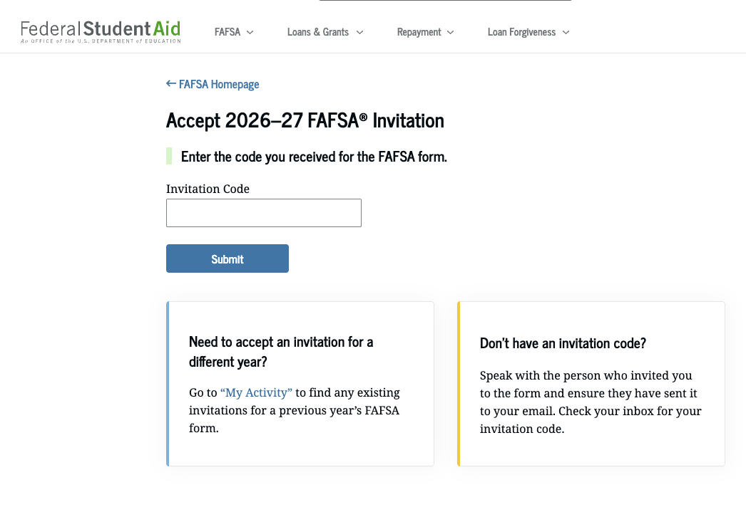
Contributor / Parent Info.
Invitation Email
  Log in / Accept invitation

Slide 30
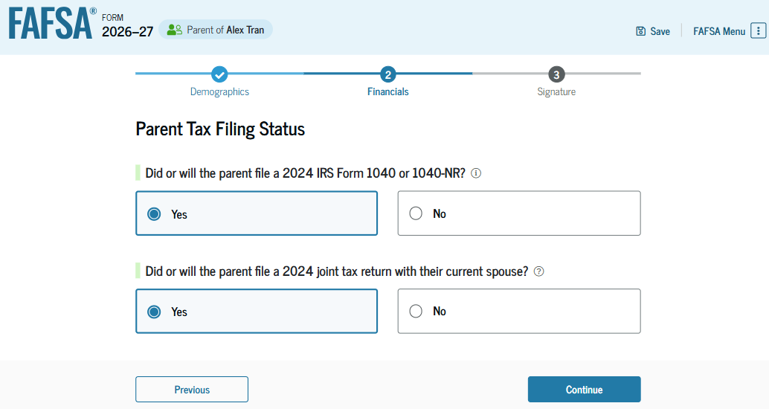
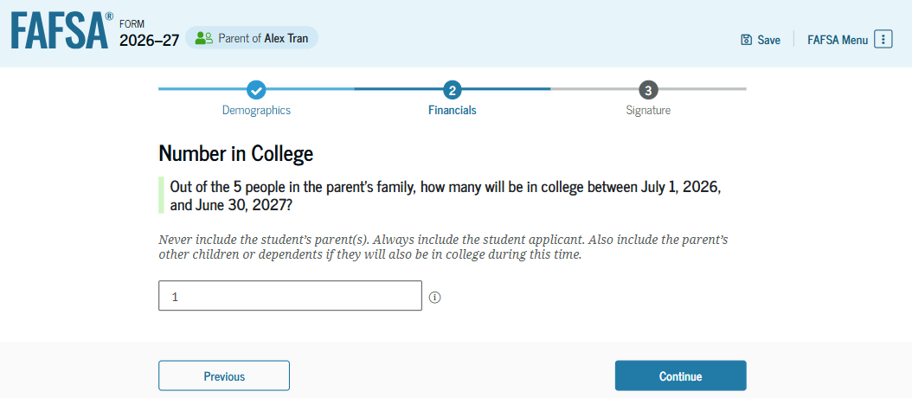
Parent Financials
Federal Benefits Received
Tax Filing Status
  Determines if one or both contributors need an StudentAid.gov Account to sign and submit
Family Size
  Could need adjusting if different from 2024 tax forms
Number in College

Slide 31
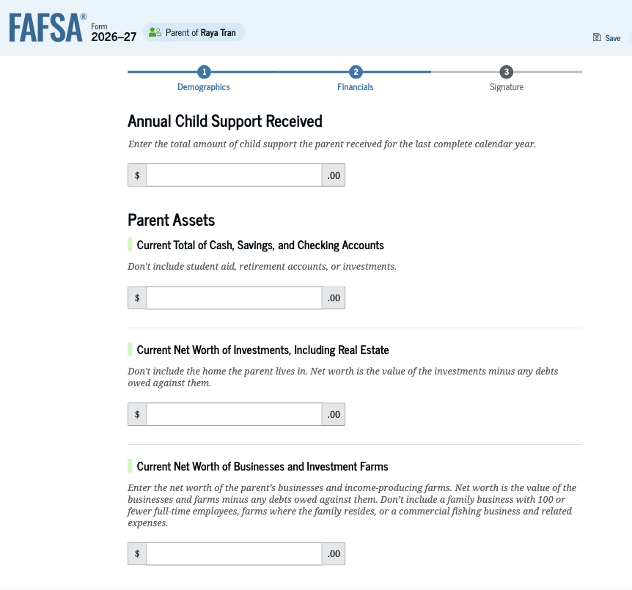
Parent Asset Information
Assets do NOT include:
  The home you live in
  Qualified retirement plans
  Businesses with less than 100 full-time
  equivalent employees
Assets DO include:
  Cash, savings, and checking accounts
  Real estate
  Stocks, Bonds, and other investments
  529 College Savings Plans
    Education savings plans are counted as an asset
    of the account owner ONLY if the account is
    designated for the student whose FAFSA is
    being completed

Slide 32
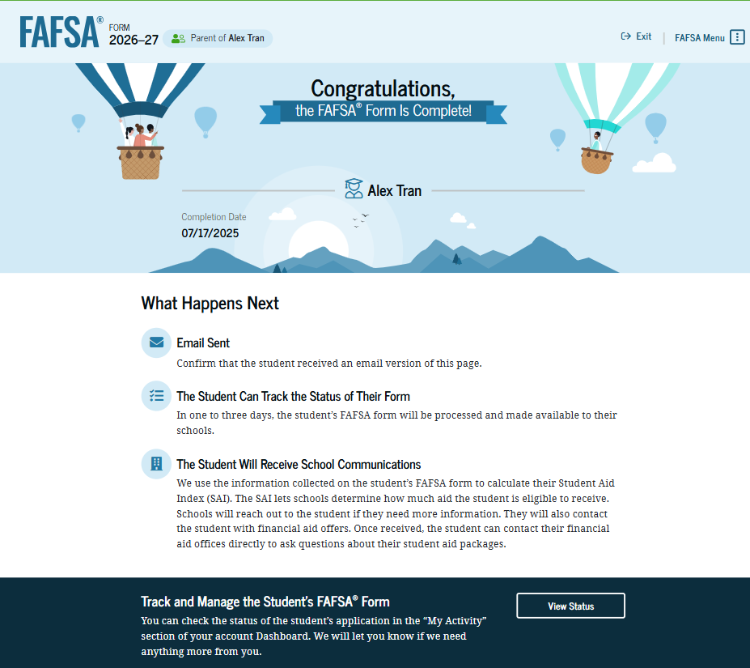
Congratulations!

Slide 33
In the News

Slide 34
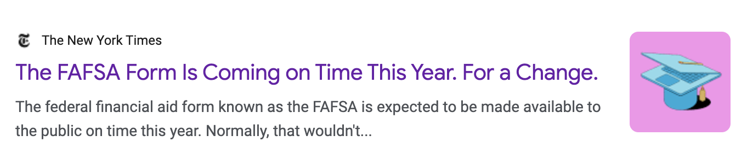
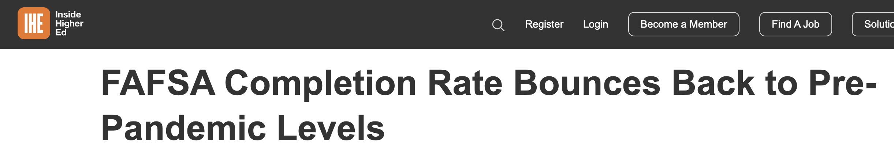
In the news…

Slide 35

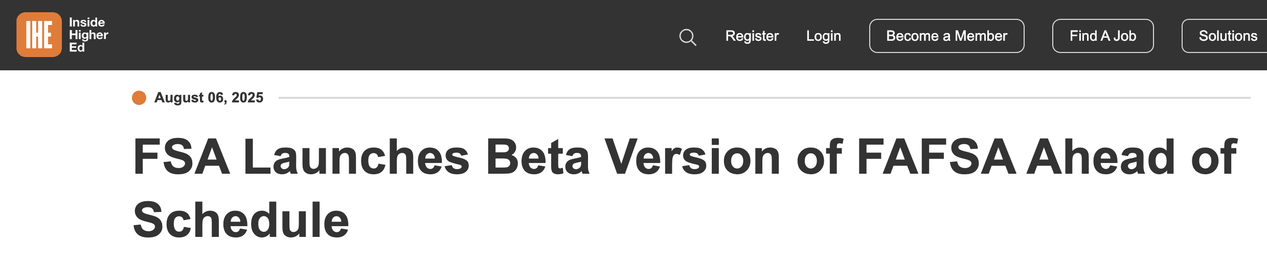
In the news…

Slide 36
Student Loan Changes

Slide 37
One Big Beautiful Bill
  Summary of Changes
  Parent PLUS Loans capped at $20,000 per year, per student, with a $65,000 lifetime maximum
    Parent PLUS Loans are no longer "full gap loans", which is expected to increase the unmet need and demand for private loans
  Grad PLUS Loan Program Eliminated
  Grad PLUS Loans are currently available in amounts up to the published Cost of Attendance ("COA") less other available aid
Direct Unsubsidized Loans for Graduate Students remains at $20,500 per year, but now subject to a $100,000 lifetime maximum (excluding undergraduate borrowing)
  Grad PLUS Loans are currently available in amounts up to the published Cost of Attendance ("COA") less other available aid

Slide 38
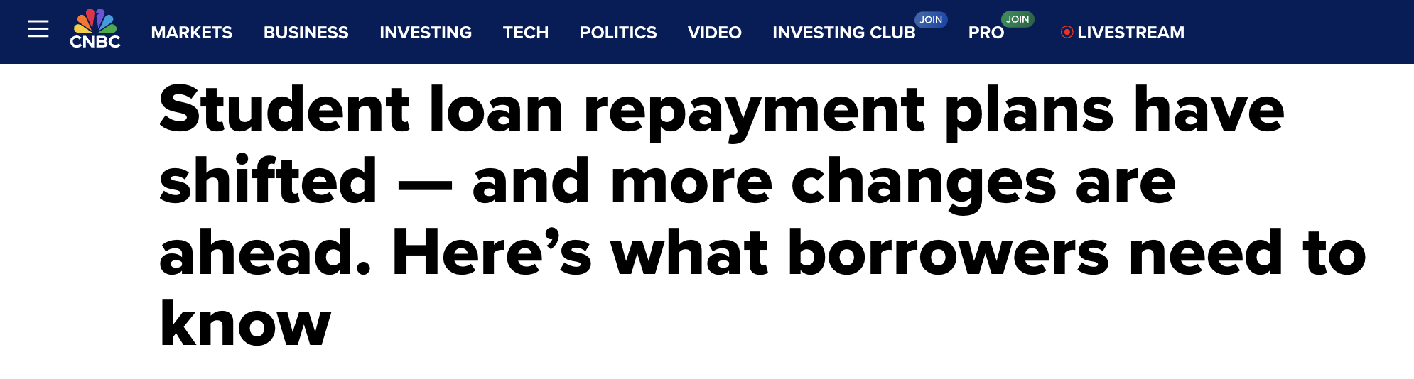
Student Loan Repayment – As of Today
Student Loan Repayment Plans:
  SAVE
  After 7/1/26 those who borrow will only have RAP and a tweaked Standard Repayment
  ICR
  IBR
  RAP

Slide 39
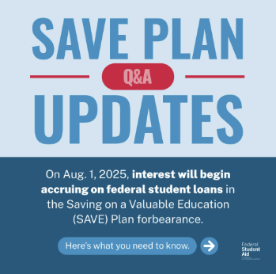

Repayment Plans
SAVE Plan – Now Unavailable
  Those that enrolled are in forbearance
  Congress repealed it
  Interest started being charged again as of
  August 1 for those in payment pause
Income Contingent Repayment Plan (ICR) Plan
  No longer concludes in forgiveness, same for PAYE
  These plans phased out as of 7/1/28

Slide 40
Repayment Plans
Income Based Repayment (IBR) Plan – IS available
  Terms are 10% of discretionary income (15% for some older loans)
  Forgiveness may come after 20 or 25 years
    IBR loan discharge paused during SAVE court decisions
    ED working on updating eligible payment counts
  Requirement to prove “partial financial hardship” to get into loan plan, now removed!
    For now, borrowers still being rejected due to their income

Slide 41

Repayment Plans
Repayment Assistance (RAP) Plan
  Will be available as of 7/1/26
  Based on AGI (Pay 1% to 10%)
  $10 / month minimum
  Forgiveness after 30 years

Slide 42
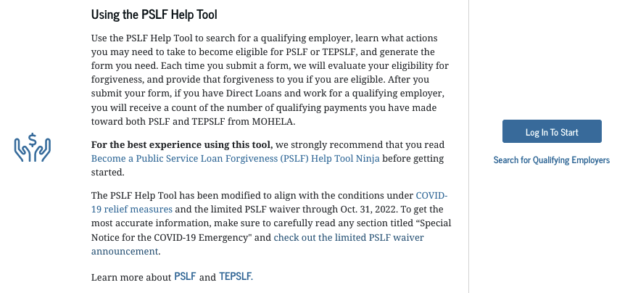
Public Service Loan Forgiveness
Benefits
  After 120 payments – remaining loan balance is forgiven
  Amount forgiven isn’t counted as taxable income for borrower
PSLF Help Tool
  Better understand the program & what is needed to participate
  Assesses if borrower works/worked for a qualified employer
studentaid.gov/pslf

Slide 43
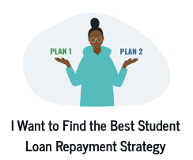
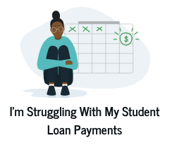
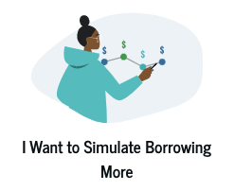
Understanding The Options
Federal loan simulator can help
  Review the repayment plans a borrower may be
  eligible for
    Getting ready to restart repayment
    Struggling with payments
  Check out impact of suspending payments
  or paying extra
  Explore impact of borrowing more

Slide 44
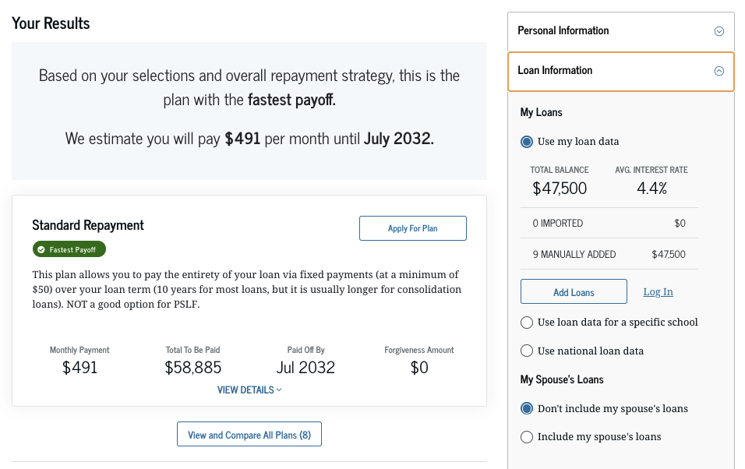
Federal Loan Simulator
Login with your FSA ID to see federal student loan repayment options
  Outcomes based on data entered like:
    Income
    Occupation (PSLF)
    Repayment goals
Does NOT include private student loans

Slide 45
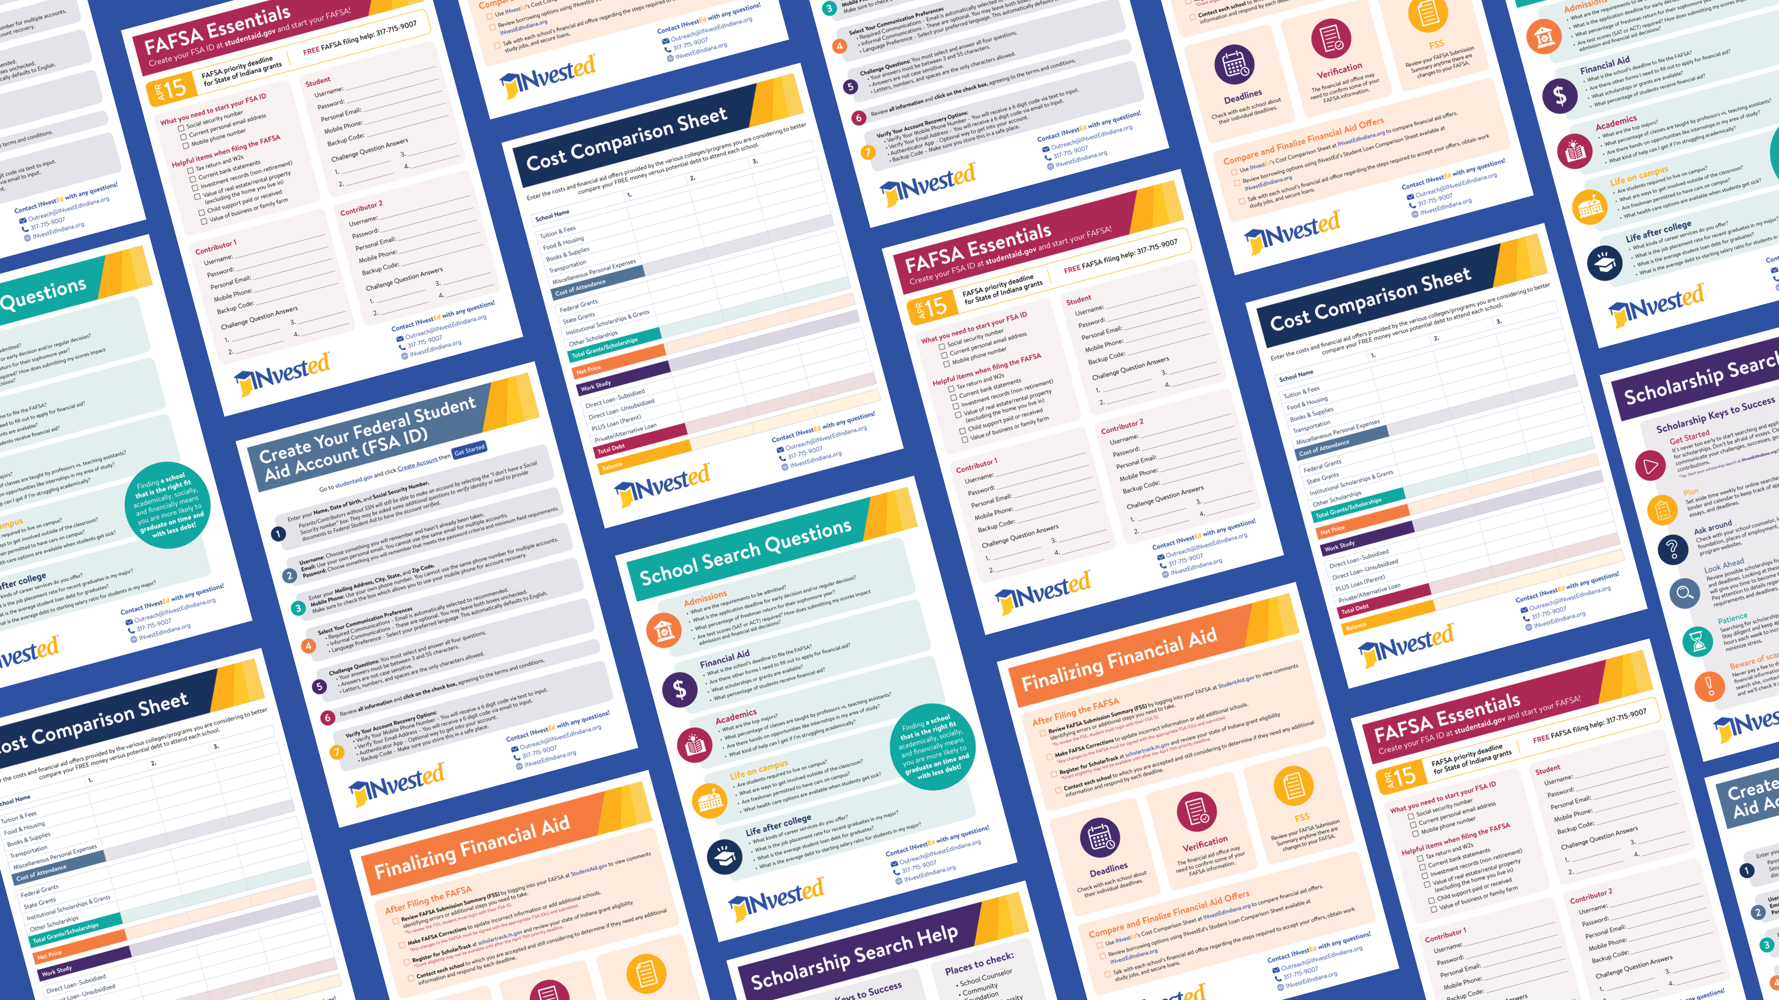
FREE Resources at:
INvestEdIndiana.org

Slide 46








Stay Connected!
William Wozniak
wwozniak@investedindiana.org
317.715.9007
Outreach@INvestEdIndiana.org
www.investedindiana.org
Follow @INvestEDIndiana
Join our mailing list:
InvestEdIndiana.org/mailing-list

